Slide 1
Teaching So Students Won’t Forget
April 24, 2021
Aaron Grossman, 4th Grade DL Teacher

Slide 2
Pennies for your thought: Identify the correct penny design
Notes:
Forty percent of people who are asked this get it right.

Slide 3
Objectives
Discover strategies to design research-based learning experiences
Consider ways to help students retain information
Learn new instructional moves, based on the science of learning

Slide 4
Working Memory
Dr. Peter Doolittle educational psychologist Center for Instructional Development and Education Research, Virginia Tech
Minutes 20:21 to 28:36 (here)
Focus Question: What is the difference between short term memory and working memory? How can our instructional design impact working memory?

Slide 5
Creating Routines
Helping kids get into routines is essential for helping with working memory. “Routines are the goal,” says Linda Hecker, MEd, the lead education specialist at the Landmark College Institute for Research and Training. “When we’re able to automate a task it no longer requires working memory to function. Remembering what to do next takes up cognitive workspace — and that’s not necessary.”
Notes:
https://childmind.org/article/how-to-help-kids-with-working-memory-issues/

Slide 6
https://www.neok12.com/

Slide 7
https://www.neok12.com/

Slide 8
HOW TO USE RETRIEVAL PRACTICE TO IMPROVE LEARNING
Notes:
http://pdf.retrievalpractice.org/RetrievalPracticeGuide.pdf

Slide 9
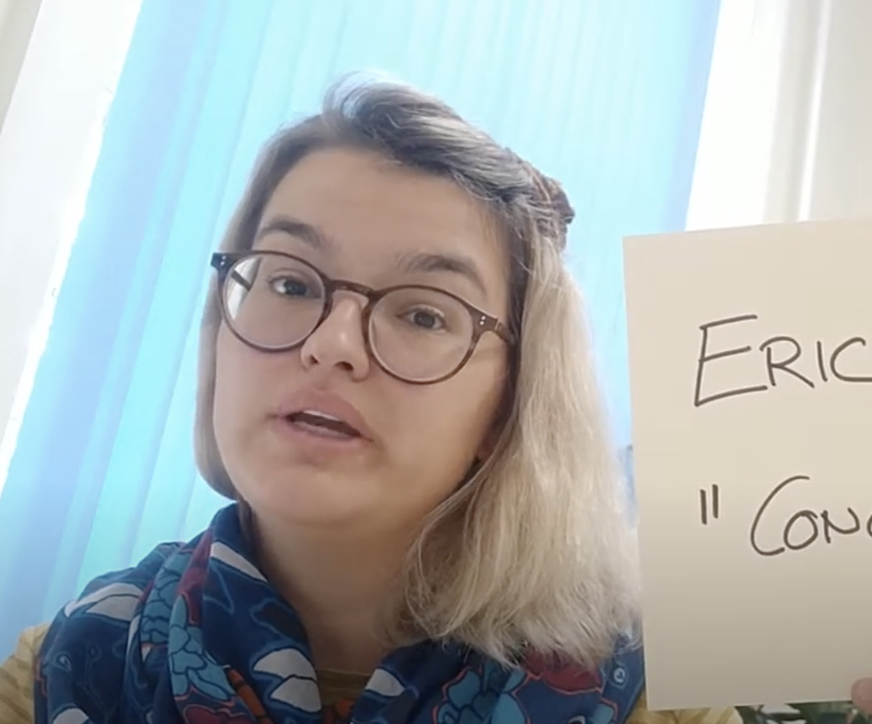
Concept Tests—An Active learning technique
Dr Carolina Kuepper-Tetzel
Based on the work of Eric Mazure
https://www.youtube.com/watch?v=791sTAhUrp8 through minute 3:08 (continue watch to learn how to write a good question)

Slide 10
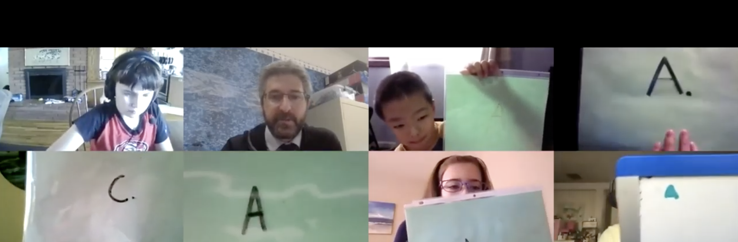
An Example
https://www.youtube.com/watch?v=7vzuWKrkqFE

Slide 11
Spaced Learning
As you watch consider
What are you already doing, matched to the idea of Spaced Learning, and
Why would this be important as we design instructional experiences for Distance Learning students?
Why does Spacing Work? (here)
The Spacing Effect (here) 19:10 to 23:12

Slide 12
Examples of the Spacing Effect

Slide 13
Examples of the Spacing Effect

Slide 14
An Example: Edpuzzle
“Edpuzzle is a web-based interactive video and formative assessment tool that lets users crop existing online videos and add content to target specific learning objectives. Teachers can search the extensive library or upload their own videos to customize them with voice-overs, audio comments, embedded assessment questions, and additional resources.” --Common Sense Media

Slide 15
Spaced Learning
As you watch consider
What are you already doing, matched to the idea of Spaced Learning, and
Why would this be important as we design instructional experiences for Distance Learning students?
Why does Spacing Work? (here)
The Spacing Effect (here) 19:10 to 23:12

Slide 16
Examples of the Spacing Effect

Slide 17
Examples of the Spacing Effect

Slide 18
An Example: Edpuzzle
“Edpuzzle is a web-based interactive video and formative assessment tool that lets users crop existing online videos and add content to target specific learning objectives. Teachers can search the extensive library or upload their own videos to customize them with voice-overs, audio comments, embedded assessment questions, and additional resources.” --Common Sense Media

Slide 19
Thank you!
Aaron Grossman
agrossman@washoeschools.net
Twitter @classroomd4
www.justtwoteachers.com
JTT on Facebook

